Slide 1
Teaching at UA: An Introduction for Graduate Teaching Assistants
Jenny Hebert, Director, Institute for Teaching , Learning, and Assessment
Elena Popa, Associate Director, Institute for Teaching, Learning, and Assessment
Notes:
Managing Difficult Students and Student Challenges as a GTA:
Now that you are a GTA here at UA, you will likely find yourself working closely with undergraduate students on campus. We have a wonderful, diverse student body here at Akron and students are often looking to their instructors and teaching assistants for guidance, support, and membership during their time here Akron. Unfortunately, sometimes students will have a difficulty in their courses, a disagreement with their instructor or TA, or personal and academic problems that get in the way of them being successful in their courses. This short video will provide some case studies that you can use to think about and consider how to respond appropriately when faced with a student issue as a GTA.

Slide 2
Quick Introductions
Meet your neighbor(s)!
  Name
  Department/School
  Classes you'll be teaching
  One hope and one fear for the semester
Notes:
Elena
Introductions are really important to foster a sense of community in our classrooms. It's important to give students the chance to meet their peers and yourself. The strategy we will be using now to have you meet your neighbors works in both small and large courses.
I will start by introducing myself: Elena, Dept of Anth/but I will soon be in Sociology, I will teach Field Methods in Cultural Anthropology; I hope to manage well the multiple and new responsibilities I have this fall; I fear that my class will face lots of challenges in regards to the community research element I would like to incorporate;
Jenny introduces herself: Hi, I’m Jenny Hebert. My home is in the English Department, but I am currently serving a the Director of the Institute for Teaching, Learning, and Assessment. My fear is that recent legislation will take the joy out of teaching for many faculty; my hope is that ITLA can help them reconnect with that joy and keep doing what they do best.
So, now I would like to invite you to meet your neighbor in the next minute or so. So, please turn to the person next to you and introduce yourself, your department/school, the classes you will be teaching and one hope and one fear you have for the semester. In case we have an uneven number, please feel free to have small groups of three, or turn to the person in front or the back to introduce yourself.
While you introduce yourself, you can also share your contact information and have a teaching buddy for the next few weeks or even the entire semester.
We will then have a few of you introduce yourselves (call on students from different colleges to get a broad perspectives on their hopes and fears).

Slide 3
Preview
ITLA and OLS Overview
Principles of Effective Course Delivery
AI Challenges with Teaching Today
Managing Difficult Students as a GTA Case Studies
Developing Positive Faculty Advisor-GTA Relationships
Work-Life Balance as a GTA
Notes:
Jenny: these are the topics we plan to touch on today, and we really do mean “touch”, as we have only one hour and lots of ground to cover. Please know, though, that there are many resources available to you at UA, including Elena and me at the Institute for Teaching, Learning, and Assessment: https://www.uakron.edu/itl/ .

Slide 4
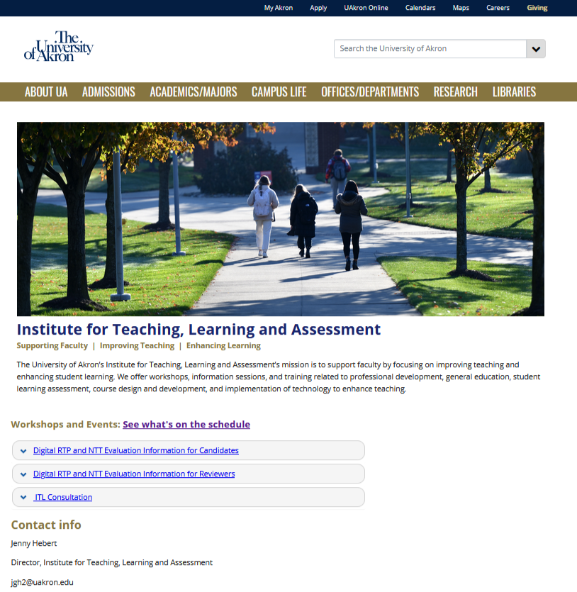
Institute for Teaching, Learning and assessment (ITLA)
Provides resources focused on improving teaching and enhancing student learning.
Workshops, Information Sessions, and Training
https://www.uakron.edu/itl/
ITL@uakron.edu.
Notes:
Jenny: to access some of the resources available to you, go to www.uakron.edu/itl/: the site for the Institute for Teaching, Learning, and Assessment (formerly the Institute for Teaching and Learning). To find out what workshops or other events are being offered, click on “See What’s on the Schedule,” which will take you to a list of current offerings, including links for registration.

Slide 5
Teaching and Senate Bill 1
Join us for a workshop on navigating SB1 in your syllabus and in the classroom. This workshop will be offered twice, each time both in person in Leigh Hall 208 and on Teams:
Wednesday, August 20: 1:00-2:30 p.m.
Friday, August 22: 9:30-11:00 a.m.
To register for remote attendance, visit the ITLA Website and click on “See What’s on the Schedule.”
Notes:
Jenny: If SB1 is weighing on you as you plan for the semester ahead, please try to attend this workshop, which is included among the current offerings for ITLA.

Slide 6
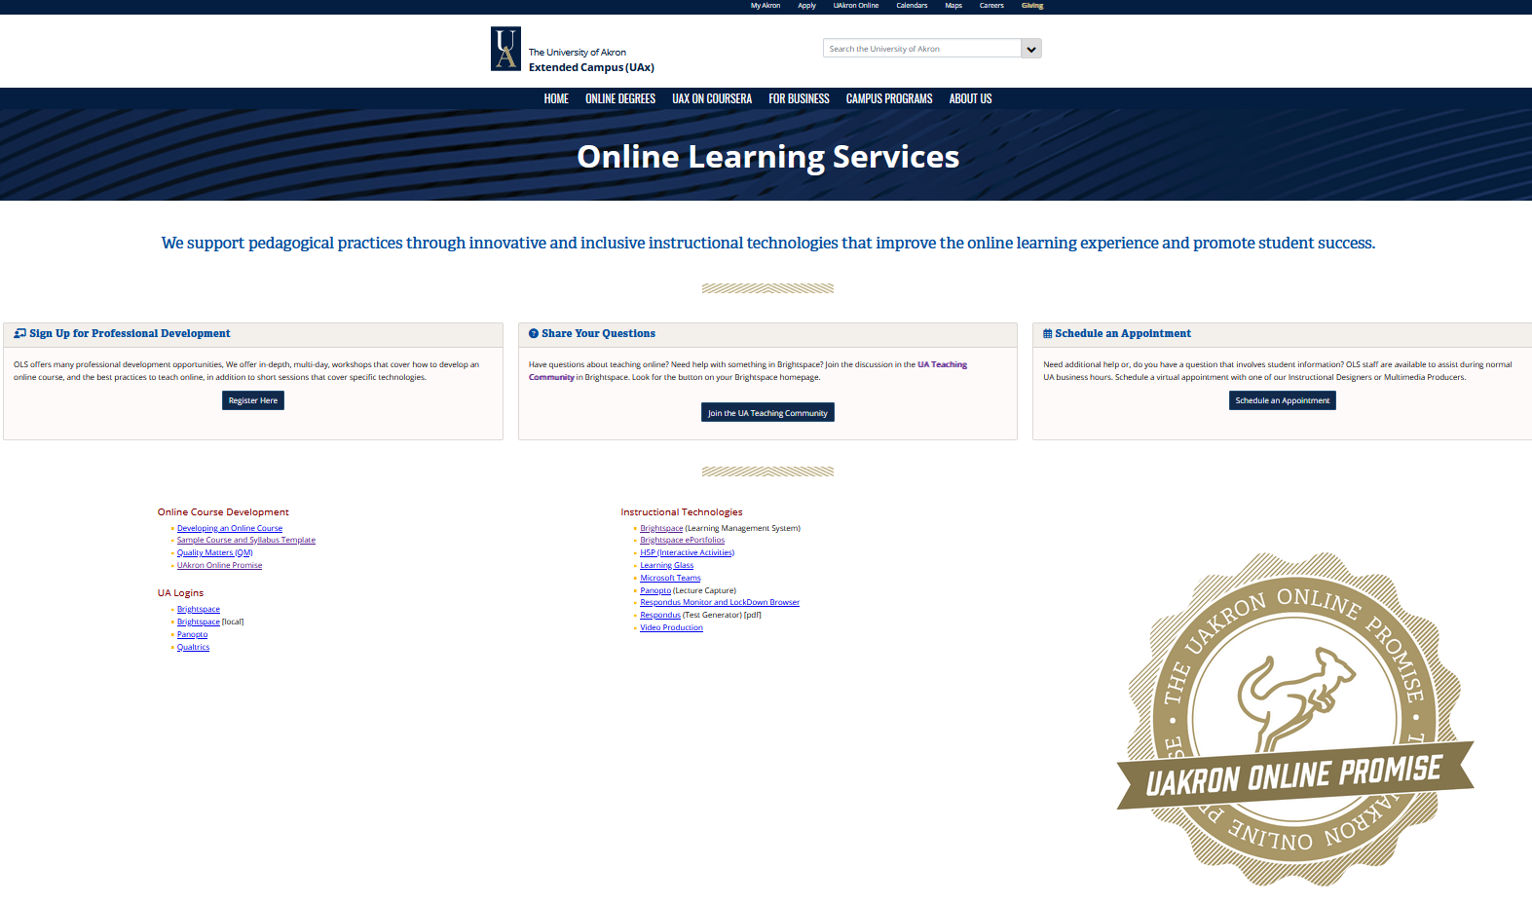
Online Learning Services
Instructional designers and multimedia experts
OLS is focused on helping all faculty (e.g., full-time, part-time, graduate teaching assistants) make the most of Brightspace
https://uakron.edu/learn/ols/index.dot
DDSHelp@uakron.edu.
Notes:
Elena: How many of you are teaching fully online classes?
Online Learning Services (OLS) has several instructional designers and multimedia experts who are here on campus and provide instructors with support for the development of online courses, instructional technologies, professional development, and individual consultations. They are the people who will help you make the most of Brightspace.
Once you are on their website you can access their schedule and sign up for the workshops you are most interested in.
If you need personalized help, you can schedule a meeting with one of them.
We also recommend that you email them at DDShelp@uakron.edu to request access to the UA Teaching Community in Brightspace where you can access guides, videos and other relevant teaching materials.
Quickly give them a sense of the resources OLS offers.

Slide 7

Brightspace Training
Brightspace Level 1 Training: August 20 and 21, 2025
Most GTAs will receive Brightspace shells from their department
Important Brightspace Features for GTAs:
  Grading
  Quizzes
  Announcements
Notes:
Jenny: Brightspace, UA’s Learning Management System (LMS) is a D2L (Desire to Learn)-based product. Using Brightspace in your courses can make life easier for both you and your students, and I highly recommend you attend some Brightspace trainings—and other types of trainings—currently offered by OLS..

Slide 8
Principles of Effective Course Delivery
Notes:
Simple concepts to keep in mind that will help you along the way

Slide 9

Be Visible and Accessible in the Classroom
First day of class introductions/ icebreakers
Keep in touch with students (e.g., announcements, emails)
Office hours
Notes:
Elena
First day of class is key to making yourself accessible in the classroom, but you can even begin that by sending a pre-semester email to welcome students to your class, share your enthusiasm about the topic or the new semester, share a bit of information about yourself (I tell students where I was born, where I studied, where I conducted research, and what I like to do when I do not work). If you have a copy of the syllabus or required textbooks you can reference that as well.
On the first day of class strive to arrive early and greet your students as they enter the classroom, you can have a slide on the projector that welcomes students to your class
Engage students in an introduction activity. If you have a very large class you can do the 1 minute meet your neighbor activity we just did earlier; you can have them fill out information on a paper you collect: I usually ask students to write down their preferred name, hometown, fun fact, something they are passionate about and any info that might help me better support them during the semester.
After the first day of class, stay in touch with students via emails and Brightspace announcements. I follow up with emails thanking them for their class participation and reminding them of the work they need to complete before the next class.
Take a moment to explain what office hours are. Not all students are familiar with this and the fact that this is a time that faculty dedicates to meet with students to address any questions or concerns. I renamed my office hours to student hours to signal that these are hours for students to come and talk to me. Also, encourage them to come to student hours.
One last suggestion here that helped me when I was in grad school, but even after I became a full time faculty. If you feel nervous before your first class, visit your classrooms before the first day of class. It will helps you calm your nerves, figure out the technology and imagine yourself as a teacher in that space. If they don’t know yet where you are teaching, I encourage you to contact your department chair or admin asap.

Slide 10
Use Inclusive Teaching Practices
“Pedagogy that strives to serve the needs of all students, regardless of background or identity, and support their engagement with subject material" (Yale Poorvu Center for Teaching and Learning, 2017).
Examples of Inclusive Teaching Practices:
  Make materials accessible (e.g., closed captioned; Yuja software and training from OLS)
  Use inclusive language
  Know and use students' names: model; ask for preferred names
  Use materials that represent diverse voices
  Invite discussion of diverse perspectives
Notes:
Jenny: inclusive teaching is simply a pedagogical approach that “Involves deliberately cultivating a learning environment where all students are treated equitably, have equal access to learning, and feel valued and supported in their learning. Such teaching attends to social identities and seeks to change the ways systemic inequities shape dynamics in teaching-learning spaces, affect individuals’ experiences of those spaces, and influence course and curriculum design” (Overview of Inclusive Teaching, 2018).” Dartmouth Center for the Advancement of Learning: https://dcal.dartmouth.edu/resources/teaching-methods/inclusive-teaching

Slide 11

Commit to Active Instruction
Active learning techniques:
  Small group discussions
  Games/gamification
  Polling
  Think-Pair-Share
Notes:
Elena
Student active participation is critical to learning; passive learning is quickly forgotten and does not help students understand the practical applications of what you teach or of what they read. So, strive to engage students in active learning.
You can set the tone for active learning in day 1 or the first time you meet with students depending on your role in the course.
Some active learning strategies are: small group discussions, games, polling, or think-pair-share.
For example, small group discussions helps students share their understanding of the material, learn from peers, build connections, develop teamwork skills. Small group discussions can also increase student engagement as some students prefer to participate in that smaller setting.

Slide 12
Provide Quality Feedback
Provide multiple opportunities for students to demonstrate learning.
Provide feedback early.
Provide students with clear instructions, rationale, and evaluation criteria.
Use rubrics.
Notes:
Jenny: feedback is often our best chance to provide individualized instruction. Written feedback also provides insight on strengths and weaknesses in student learning, which gives us the opportunity to correct course as/if necessary.

Slide 13
AI Challenges
ChatGPT, Bard AI, Bing AI, Elicit, etc.
UA Policy
Explaining ethical and unethical uses of AI to students.
Model and incorporate
Ethical Use of AI: AI tools (such as ChatGPT) are powerful tools that can be used to aid in the learning process. Students should look to their instructors for guidance on the fair and ethical use of AI tools for this course. The inappropriate or unethical use of such technologies will violate the Code of Student Conduct as cheating, plagiarism, fabrication, unauthorized collaboration, misrepresentation, and/or gaining an unfair advantage. The Code of Student Conduct is a University rule that provides the framework for the student conduct process at the University of Akron and defines student misconduct and the process that the University will use to address student misconduct reported to the Department of Student Conduct and Community Standards. Students at the University of Akron are responsible to know and abide by the Code of Student Conduct and all University rules, regulations, and policies.
Notes:
Jenny: Sign up for Chronicle of Higher Education newsletters: free to UA community (UA net ID) and search for other resources. Ongoing and evolving issues. TEach students the values, benefits, and drawbacks of using AI. Consult with the course director/coordinator for specific approaches.

Slide 14
Managing Difficult Students and Student Challenges as a GTA
Notes:
Elena
As an instructor, you will probably have to manage some difficult students and student challenges. So, let's turn to some case studies and see how you could manage these situations.

Slide 15
Case Study 1: Melissa
Melissa has been a great student for most of the semester in your College Writing course. However, over the past couple of weeks you have noticed that she is quiet in class.
You are grading the weekly reflection activity and find the following comment on Melissa’s submission:
  I am really struggling with finding the motivation to write this reflection entry this week. I honestly feel like I have nothing to say and I am not really sure if I want to even stay in school.
Notes:
Elena
Let’s start with the first case study – Melissa's case..
First, think about your reaction? What would you like to do and how would you like to act in this situation? Let's take one minute for you to think individually, then turn to your neighbor and share your thoughts.
As a GTA, you may be wondering, “What should I do?”
Here are some tips you can use to help Melissa. First, acknowledge Melissa’s concerns, especially that many students struggle to stay motivated throughout the semester. Do not accuse her of slacking off, but instead try to understand what underlying issues may be contributing to these challenges. For example, maybe she is working a lot of hours to pay for school or maybe she is dealing with depression. Next, consider referring her to ZipAssist using the ZipAssist website. They may be able to reach out and see about connecting Melissa to on-campus resources, such as tutoring, counseling services, or an academic advisor who can work directly with Melissa to help her in her studies. Finally, let Melissa know that you are there for her as her TA. See if setting up a study schedule or weekly coaching meetings via Teams is something she would be interested in to help her get back on track in the class.

Slide 16
Tips you can use for Melissa
Acknowledge her concerns since many students struggle to stay motivated
Do not accuse her of slacking off, try to understand what causes her challenges (long working hours, mental health, finances, etc.)
Consider referring her to ZipAssist; they may be able to reach out and connect her to on-campus resources who can work with Melissa directly
Let Melissa know that you are there for her as her TA and see if she might be interested in weekly meetings to help her get back on track
Notes:
Here are some tips you can use to help Melissa. First, acknowledge Melissa’s concerns, especially that many students struggle to stay motivated throughout the semester. Do not accuse her of slacking off, but instead try to understand what underlying issues may be contributing to these challenges. For example, maybe she is working a lot of hours to pay for school or maybe she is dealing with depression. Next, consider referring her to ZipAssist using the ZipAssist website. They may be able to reach out and see about connecting Melissa to on-campus resources, such as tutoring, counseling services, or an academic advisor who can work directly with Melissa to help her in her studies. Finally, let Melissa know that you are there for her as her TA. See if setting up a study schedule or weekly coaching meetings via Teams is something she would be interested in to help her get back on track in the class.

Slide 17
Case Study 2: TJ
TJ has missed multiple class meetings this semester in your lab section. His lab reports have also gotten low grades consistently.
It is week 11 in the semester, and you receive the following email from TJ:
  Hi TA Smith: I was looking at my Brightspace grades today and I’m not sure why I have such a low grade. I know I missed a couple of classes, but those were for athletics reasons. I really need to pass this class and I think that you can give me some additional points on my lab reports. -TJ
Notes:
Elena
In our second case study, we have TJ enrolled in a lab section that you are serving as the TA for this semester. Students are required to attend every lab session, but TJ has missed several classes. While a couple of the absences were sports-related, he has missed other classes without a documented excuse. When he has submitted his lab report assignments on Brightspace they have not included all of the required information. It is now Week 11 and TJ has a 57.89% in the class and you receive the following email from TJ:
Hi TA Smith: I was looking at my Brightspace grades today and I’m not sure why I have such a low grade. I know I missed a couple of classes, but those were for athletics reasons. I really need to pass this class and I think that you can give me some additional points on my lab reports. -TJ
This situation is unfortunately one that you might encounter. Some ways to handle the situation include, scheduling a face-to-face meeting with the student to discuss the expectations of the course, where he has missed points on previous assignments, and what he can do in the final few weeks to turn his grade around. Be careful to not to respond defensively via email and escalate the conflict. Instead be open and listen to the student’s side of the story. If the student becomes frustrated or becomes verbally aggressive in the exchange, stay calm and provide the student with the contact information for the faculty member who coordinates the course and document the student’s conduct and report it to your supervisor.

Slide 18
Tips you can use for TJ
Schedule a face-to-face meeting with the student to discuss course expectations, where he has missed points, and what he can do to turn his grade around
Be careful not to respond defensively over email and escalate the conflict
Be open and listen to the student's side of the story
If the student become frustrated or verbally aggressive, stay calm and provide the student with the contact information of the faculty coordinating the course
Document the student's conduct and report it to your supervisor
Notes:
This situation is unfortunately one that you might encounter. Some ways to handle the situation include, scheduling a face-to-face meeting with the student to discuss the expectations of the course, where he has missed points on previous assignments, and what he can do in the final few weeks to turn his grade around. Be careful to not to respond defensively via email and escalate the conflict. Instead be open and listen to the student’s side of the story. If the student becomes frustrated or becomes verbally aggressive in the exchange, stay calm and provide the student with the contact information for the faculty member who coordinates the course and document the student’s conduct and report it to your supervisor.

Slide 19
Case Study 3: Allison
Allison is enrolled in your Introduction to Psychology course and has been a good student this semester.
This week students had to write a 3-page case analysis paper. When grading Allison’s paper you noticed that some of the content seemed off. You suspect she used AI. What should you do?
Student Conduct and Community Standards
Notes:
Jenny
In our final case study, we will consider what to do if a student plagiarizes in a course you are the instructor or TA in. In this case Allison submits a paper that includes almost 50% of plagiarized content. You may be struggling with knowing what is the right thing to do in this case since Allison has been a good student in the course up until now.
First, discuss the case with your supervisor so they are aware that you are dealing with a plagiarism case in one of your classes. As a GTA, you will want your supervisor to know about this and see if they want to intervene or if they would like you to work with the student. If you are asked to address the matter with the student you will want to schedule a meeting with Allison to discuss the plagiarism in her paper. Point out how the content was plagiarized, whether it was missing quotation marks because the content was copy-and-pasted from another source or did not attribute paraphrased content to the original source. Further, explain to Allison how plagiarism is against the rules in the University of Akron Student Code of Conduct and can result in failure of an assignment, course, or further actions. Allow Allison the opportunity to explain how she made the mistake and provide her with resources on how to make sure she does not make the mistake again in the future including the Purdue OWL website and the Writing Center on campus. Finally, make a decision about how to handle the student grade. It may make sense to give Allison a zero for this assignment, however, if there were extenuating circumstances, such as maybe she did not realize she plagiarized, you may want to give her a second chance to make up the assignment correctly. With all plagiarism cases you will need to complete the academic misconduct notification form that you can find on the Academic Misconduct Referral Process webpage which is linked in this Brightspace module. If you cannot resolve the plagiarism issue informally, you may need to refer to the case to Department of Student Conduct and Community Standards for adjudication.

Slide 20
Key Takeaways
Be understanding.
Provide resources.
Be firm.
Reach out to supervisors and campus administrators for support.
Notes:
Jenny: As a GTA it can be especially hard to know where to turn when you encounter student issues or challenging students. Remember to first be understanding and empathetic towards students. Many undergraduate students will make mistakes and will learn valuable lessons from these mistakes. Give them the opportunity to be accountable for these issues and provide them with the resources they need to be successful in the future. Next, do not be afraid to be firm and stick to your policies. If a student questions a policy or believes they are an exception, it is okay to hear them out but know that you need to use the same set of policies for all students in the class to be fair and objective. Finally, when there is a concern or challenge with a student, reach out to your advisor or supervisor or the office of student conduct for support. These senior faculty members and administrators have a lot of experience with challenging students and can step in to help manage the situation if needed.

Slide 21

Developing Positive
Faculty Advisor-GTA Relationships
Make expectations clear
Keep lines of communication open
Be reliable
Be accountable
There may be bumps in the road
Notes:
Elena
It's important to cultivate positive relations with your faculty advisors or course directors. These faculty play instrumental roles in your grad school careers and will be the ones who will likely write letters of recommendation for you as you approach the job market stage of grad school. I always had a couple of faculty write about my research in their letters and one that wrote about my teaching.
Make sure you understand your advisors' expectations about deadlines, meetings or feedback; and do not be afraid to ask for clarifications;
Keep lines of communication open and be proactive in scheduling meetings to discuss your progress or the challenges you are facing.
Be reliable and accountable
There may be bumps in the road, so if you anticipate or face challenges communicate with your advisor

Slide 22

Work-Life Balance as a GTA
Build a support system
Find the right balance of work-family-play
Practice mindfulness
Reach out for help when needed
Celebrate accomplishments – big and small
Notes:
Jenny: What is that?!? While graduate school is likely not going to be the most balanced time in your life, it is important to give yourself permission to take breaks—and seek balance. Here are just a few suggestions we would offer along those lines.
Be gracious, though, and remember that you are doing your best to juggle many demands—and many important aspects of life. Accept some imperfection and know that support is available—in many forms! Don’t be afraid to draw on that support when needed!

Slide 23
Questions?
Thank you!
Notes:
Jenny

